Slide 1
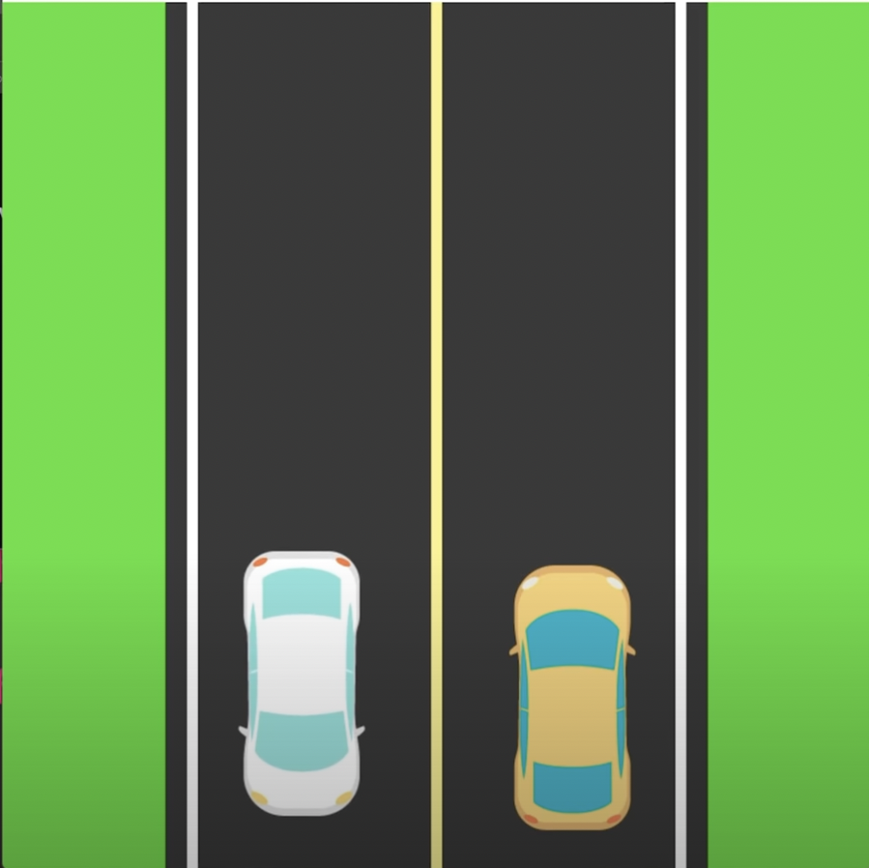
Simple Car Race Game
By Gates Ogork
CONCEPT:
A simple car game where users can switch side to side to avoid oncoming traffic on a highway. This program uses simple python concepts learned in this course such as if, while, and for loops.
https://github.com/ksu-is/CarRaceGame

